Slide 1
It‘s Quiz Time!

Slide 2
Where is Europe’s highest toilet located?
On the Zugspitze
Atop the Eiffel Tower
On Mont Blanc

Slide 3
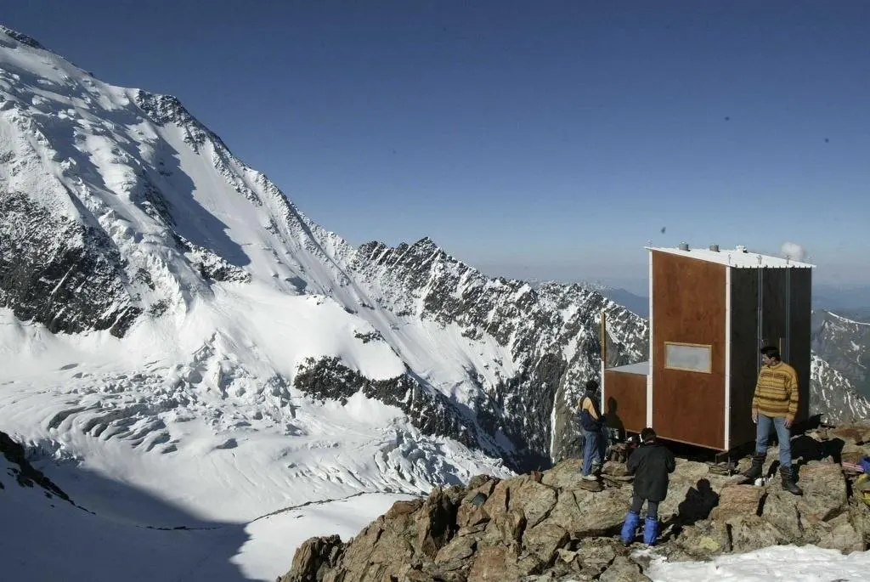
Where is Europe’s highest toilet located?
On Mont Blanc
Notes:
The highest toilet in Europe is located on Mont Blanc, the highest mountain in the European Union, at an altitude of 4260 metres. The toilet was built in 2007 for mountaineers.

Slide 4
This is where representatives elected by EU citizens come together.
The European Parliament
The European Commission
The European Council

Slide 5
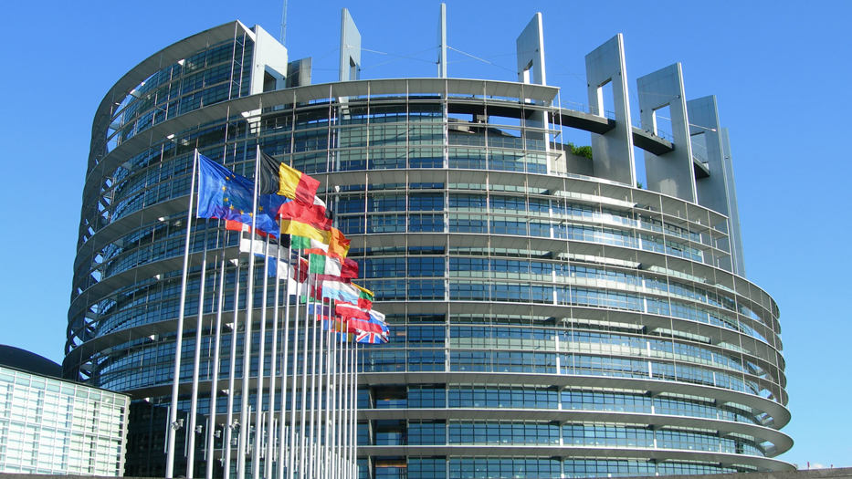
This is where representatives elected by EU citizens come together.
The European Parliament
Notes:
The European Parliament is directly elected by EU voters every 5 years.

Slide 6
All heads of state and the government of the EU member states meet here.
The European Commission
The Court of Justice of the European Union
The European Council

Slide 7
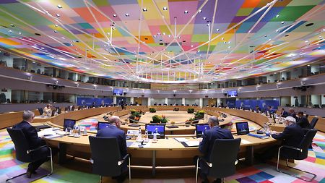
All heads of state and the government of the EU member states meet here.
The European Council
Notes:
The European Council brings together EU leaders to set the EU's political agenda. It represents the highest level of political cooperation between EU countries.
One of the EU's 7 official institutions, the European Council takes the form of (usually quarterly) summit meetings between EU leaders, chaired by a permanent president.

Slide 8
Here, exactly one person represents each EU country. This group represents the interests of the entire EU.
The European Parliament
The European Commission
The Council of the European Union

Slide 9
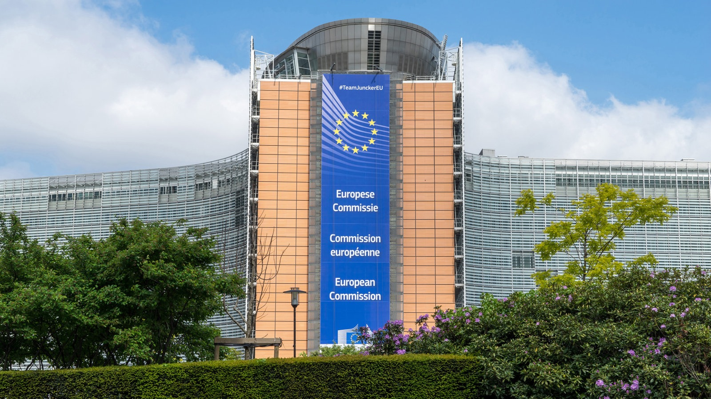
Here, exactly one person represents each EU country. This group represents the interests of the entire EU.
The European Commission
Notes:
The task of the European Commission is to represent the interests of the entire European Union.
After the European elections, the European Council proposes a candidate for the office of President of the Commission, who must be confirmed by the European Parliament by an absolute majority.
According to the Treaty of Lisbon, the European Council must take into account the result of the European elections. The President of the Commission then puts together his or her Commission team.

Slide 10
This institution meets in ten differently composed groups depending upon the issue at hand.
The European Council
The Council of the European Union
The European Parliament

Slide 11
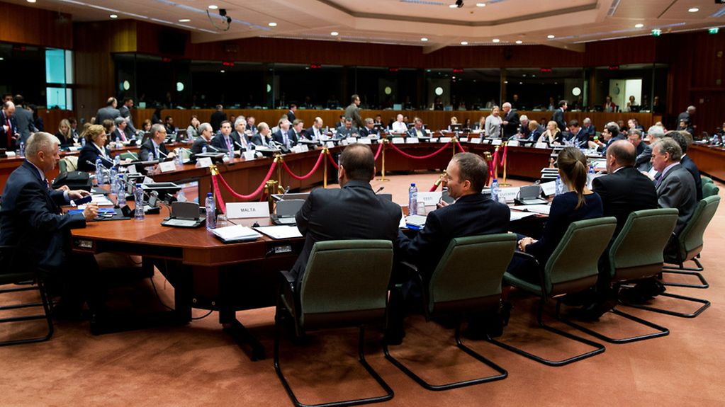
This institution meets in ten differently composed groups depending upon the issue at hand.
The Council of the European Union
Notes:
In the Council of the EU, informally also known as the Council, government ministers from each EU country meet to discuss, amend and adopt laws, and coordinate policies. The ministers have the authority to commit their governments to the actions agreed on in the meetings.

Slide 12
Which of the following institutions is not part of the EU?
The European Commission
The European Council
The Council of Europe

Slide 13
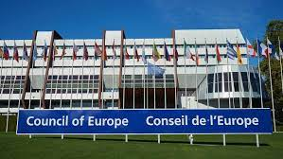
Which of the following institutions is not part of the EU?
The Council of Europe
Notes:
Founded in 1949, the Council of Europe (today (2023) 46 member states / until 2022, 47 – Russia had to leave because of the war) is not an EU institution. The Council of Europe is a forum that is used to discuss general European issues. Since the mid-1990s, it has been primarily concerned with the issue of security in Europe and the protection of democracy and human rights.

Slide 14
When did the first direct elections for the European Parliament take place?
1957
1979
2009

Slide 15
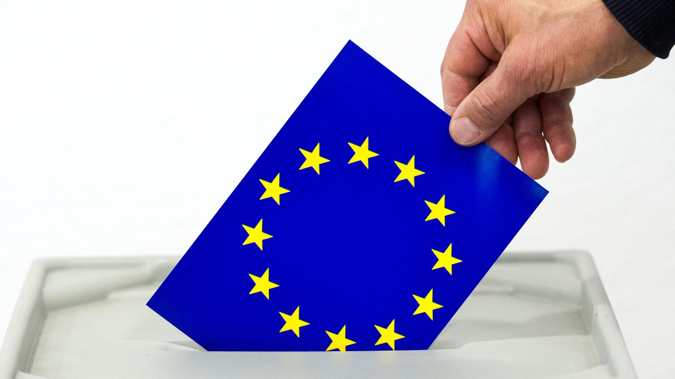
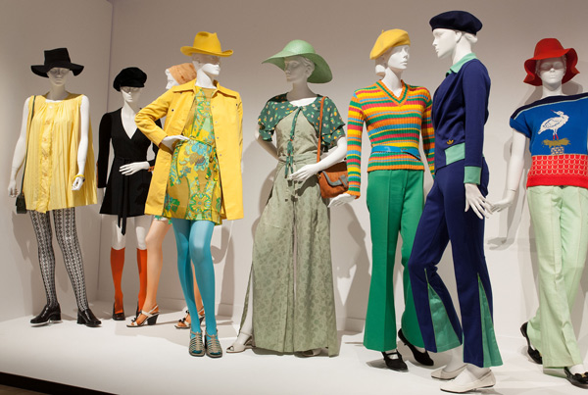
When did the first direct elections for the European Parliament take place?
1979
Notes:
1979: The European Parliament is directly elected for the first time.
Previously, the Parliament was not directly elected by EU citizens, but by representatives of the national parliaments. The direct election to the European Parliament was intended to promote public participation in the EU and democratise the EU.
1957: The Treaty of Rome creates the basis for a common market.
2009: The Treaty of Lisbon puts the EU on a new contractual footing.

Slide 16
These institutions can amend proposals for new laws in the EU and must approve new laws.
The Council of the European Union and the European Parliament
The European Parliament and the European Council
The European Court of Justice and the European Parliament

Slide 17
These institutions can amend proposals for new laws in the EU and must approve new laws.
The Council of the European Union and the European Parliament

Slide 18
How many citizens live in the EU?
ESTIMATE!

Slide 19
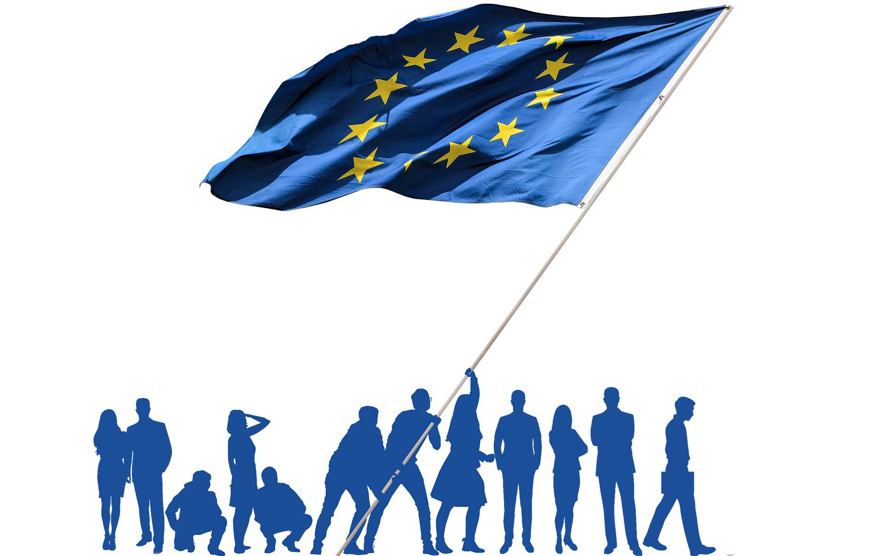
How many citizens live in the EU?
447 million
Notes:
As of 2023, around 447 million people live in the EU (source: Eurostat). Before the withdrawal of Great Britain, the figure was around 513 million.

Slide 20
Which of these three employers has the most employees?
Frankfurt Airport
The City of Hamburg
The European Union

Slide 21
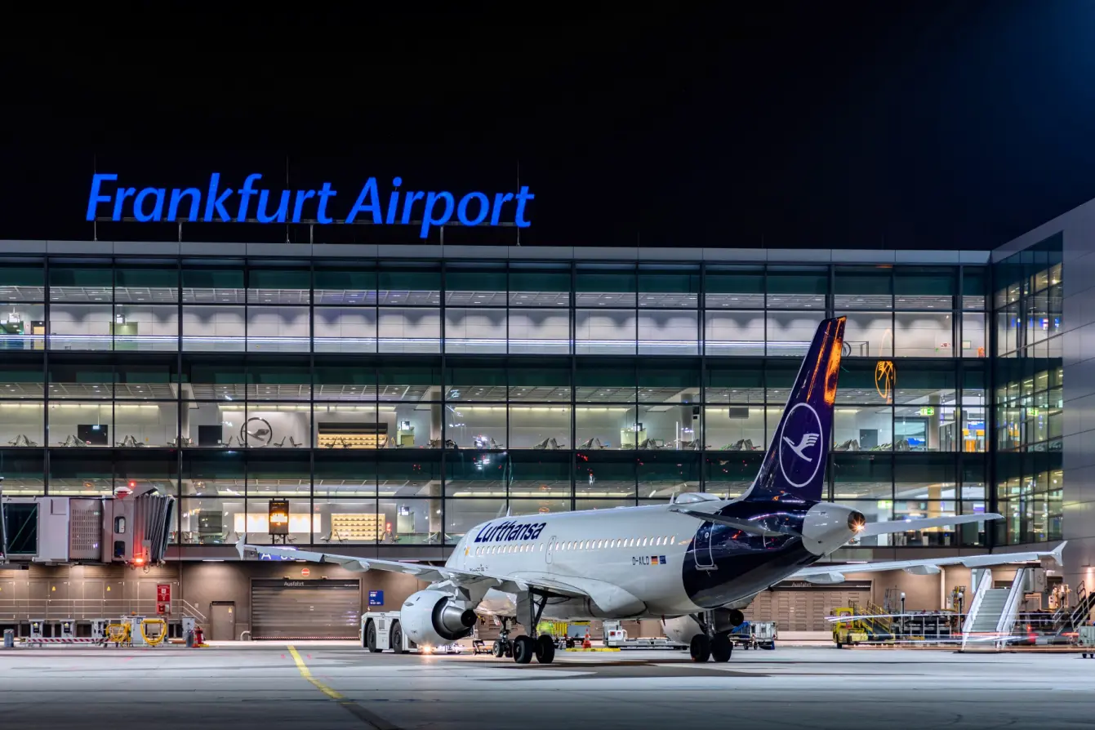
Which of these three employers has the most employees?
Frankfurt Airport
Notes:
Frankfurt Airport employs around 80,000 people, and the city of Hamburg 75,000. The European Union and its institutions, such as the European Parliament, employ a total of 60,000 people.
This means that more people work for the city of Hamburg (1.8 million inhabitants) than for the EU, which is home to around 450 million people! But remember: the city of Hamburg also employs many people in the fire brigade and in hospitals, whereas the EU does not. That is one explanation for this difference.
Status: 2023

Slide 22
How many official languages does the EU have?
3
24
27

Slide 23
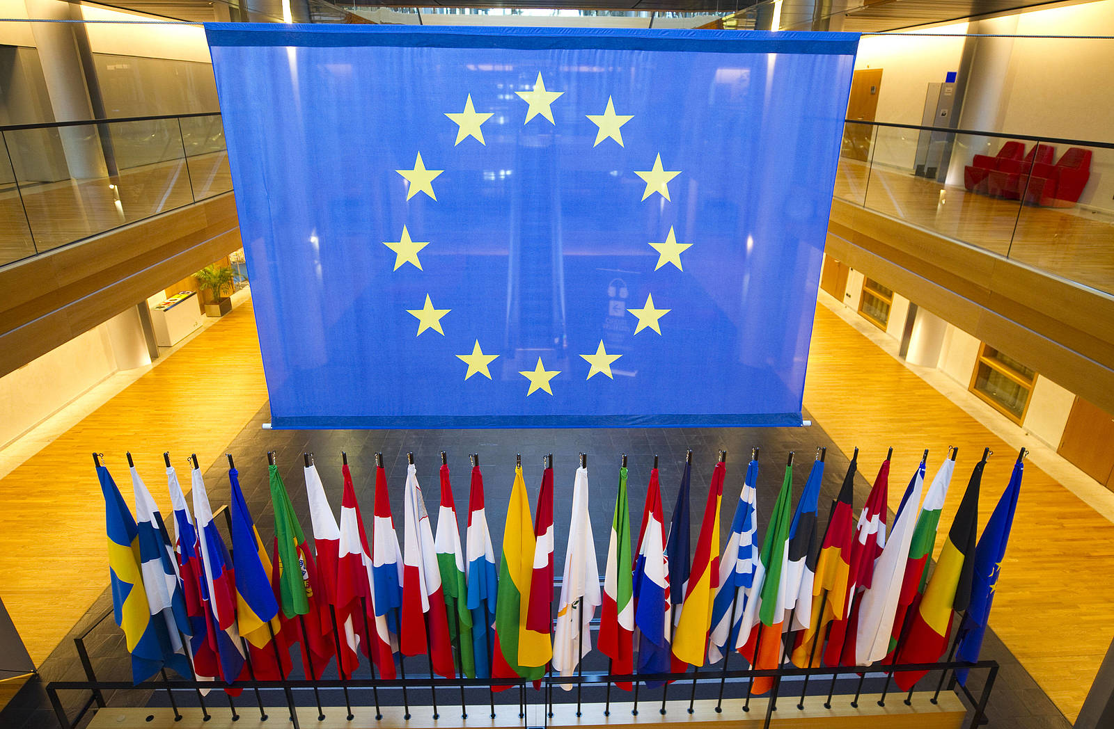
How many official languages does the EU have?
24
Notes:
Three "lingua franca": German, English, French.
24 official languages into which all EU documents must be translated.

